Slide 1
Accessing the Curriculum for Diverse Learners
Being a Literacy Partner

Slide 2
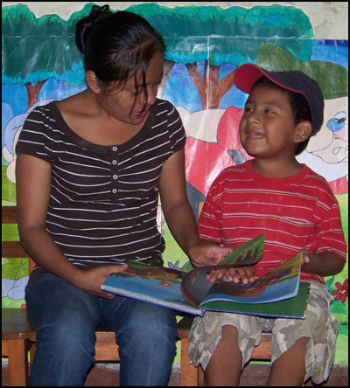
Literacy is Social
Interaction between a student and an educator as they look at or read a book is foundational to literacy development
Shared reading includes a lot of talk about books and concepts related to text

Slide 3
Reading in the classroom
Silent reading
Interactive reading
Shared reading
Guided reading
Read alouds
Independent reading
Buddy reading
Others???
Tape assisted reading
Dialogic reading

Slide 4

Reading Levels
Independent level: 95-100% accuracy
Instructional level: 90-94% accuracy
Frustration level: below 90% accuracy

Slide 5
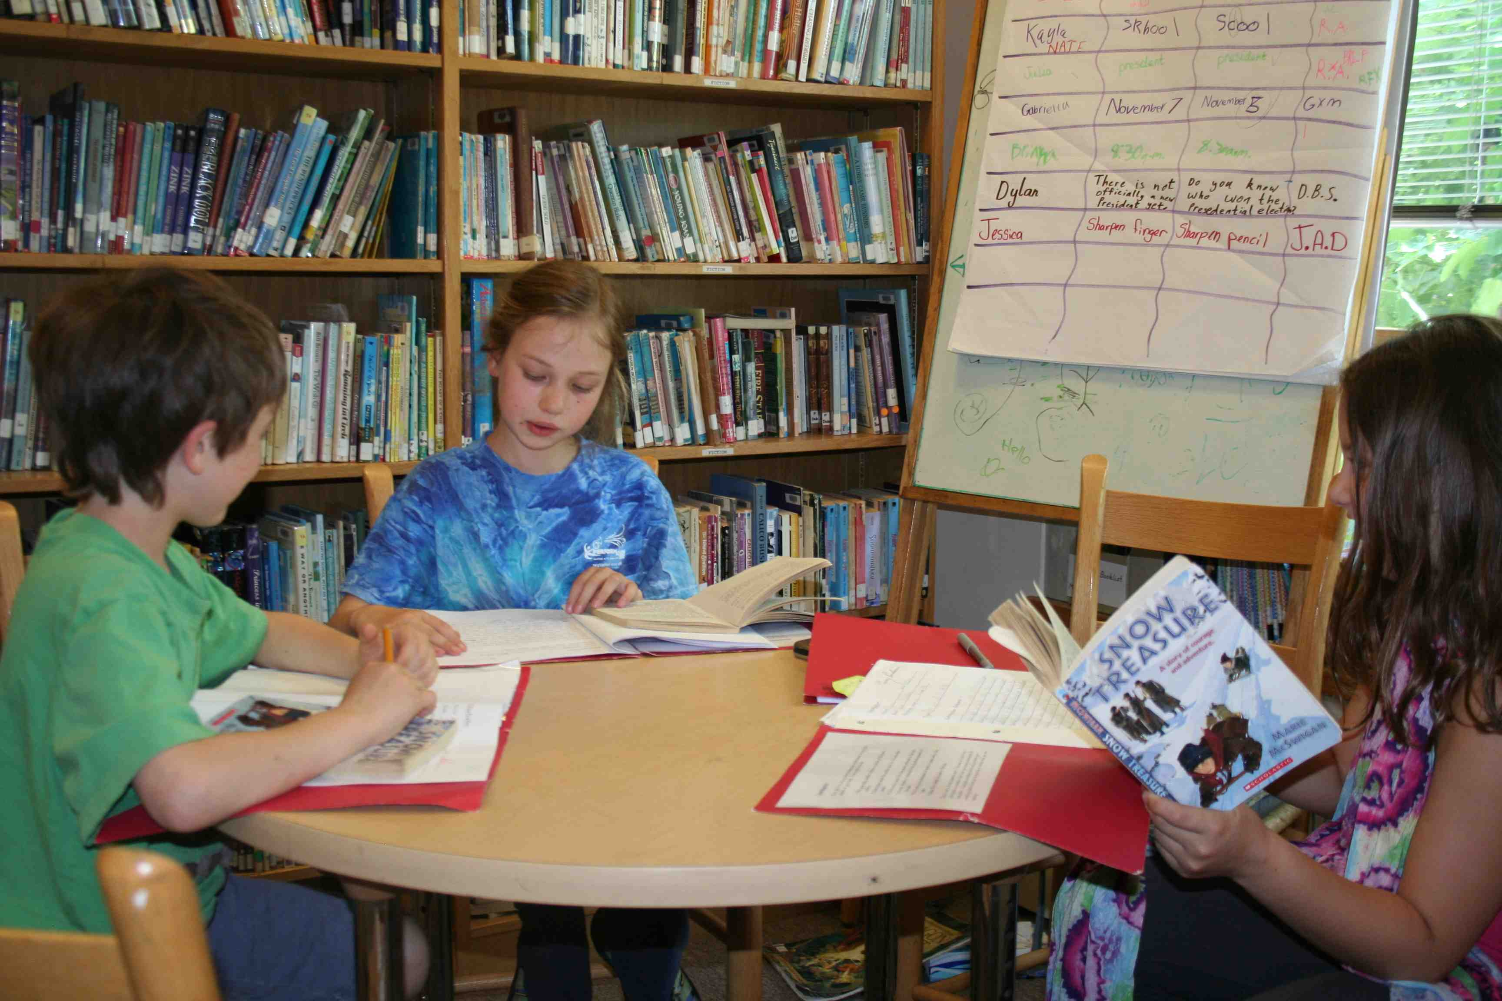
Independent Reading Level
“Easy” text:
Read almost every word
Understand almost every idea
Feel confident
Use to practice fluency
Read without assistance

Slide 6
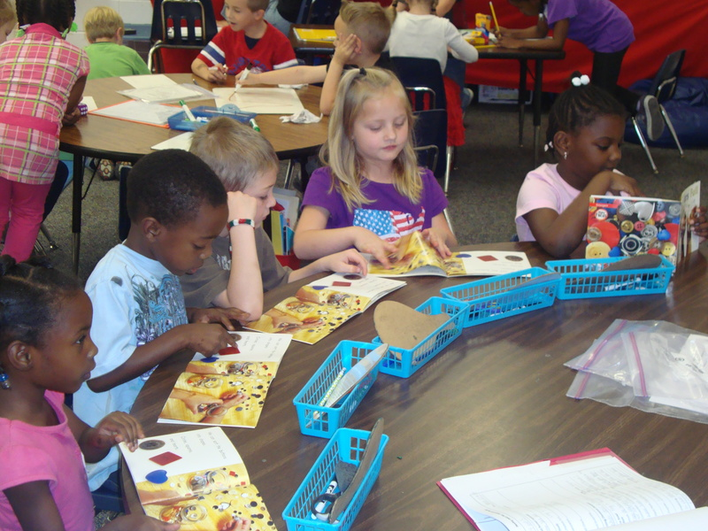
Instructional Level
“Just right” text:
Can read most of the words
Need some guidance
Understand most of the ideas
Feel challenged but not frustrated
Use for guided instruction

Slide 7

Frustration Level
“Challenge” text
Cannot read any of the words
Cannot understand many of the ideas
Can sometimes read the words but not make sense of the ideas
Great difficult reading even with assistance
Lose skills when continually exposed to texts that are too difficult

Slide 8

Selecting Books
Student Interests
Curriculum
Reading Level
Type of Book
Age appropriate
Instructional Purpose
Content, complexity of sentences, words, graphics, print

Slide 9
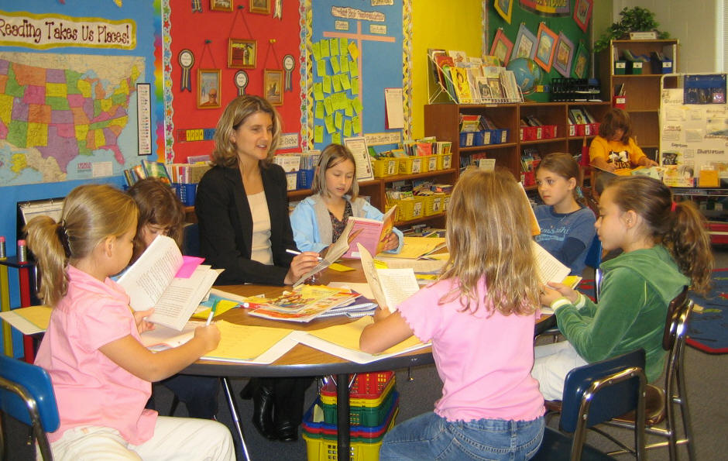
Guided Reading
Bridge to independent reading
Conducted in a small group by the teacher
Books are at the student’s instructional level, with each student having access to the text
Focused instruction goes beyond decoding
Teacher guides the students in developing language comprehension and strategies to read and understand a wide variety of texts
Not much discussion during book reading

Slide 10
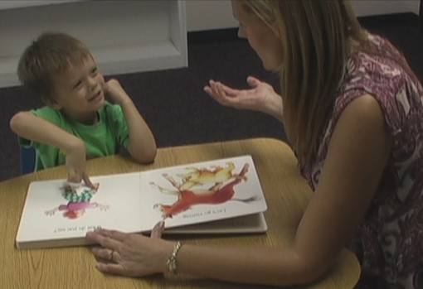
Shared Reading
Students are learning about how a book works
Students are learning about concepts of print
Students participate on every page – props, objects, symbol may be incorporated
Texts are often easy
Conducted in whole class, small group or 1:1
Students often engage in echo or choral reading
Teacher often uses the same book over several days to teach specific skills.

Slide 11
Both Guided and Shared Reading
Before
Introduce the text
During
Read the text
After
Complete a task related to the text

Slide 12
Before-During-After Framework
Before
Focus attention
Develop background knowledge
Teach vocabulary words and concepts
Conduct a picture walk
Make predictions
Preview the text
Set a purpose
During
Remind students of the purpose
Ask questions & monitor comprehension
Stop a specific points and actively engage students
After
Cycle back to the purpose
Complete a task related to the text
Support students to understand what they have achieved

Slide 13
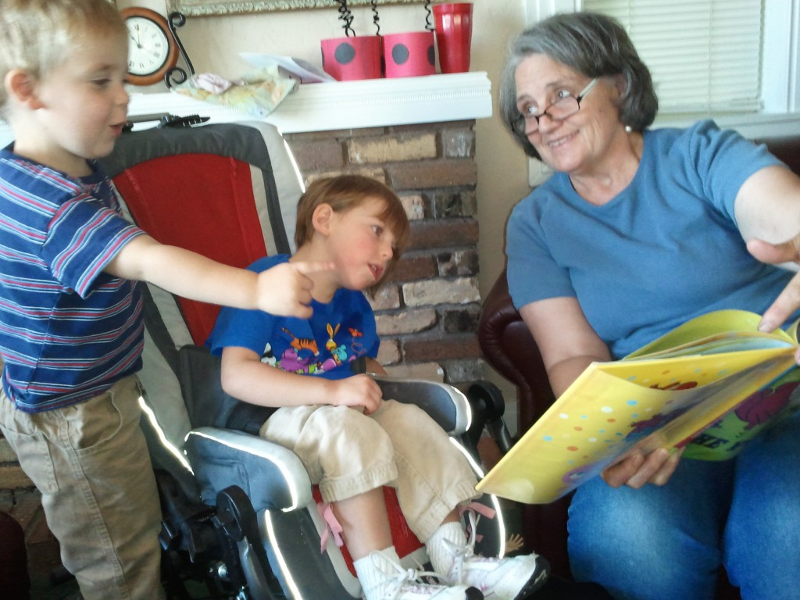
Reading with intention
Simple adjustments in the focus of book reading can accelerate students’ learning in different areas
Educators tailor the interaction to the student’s interests, attention and need

Slide 14
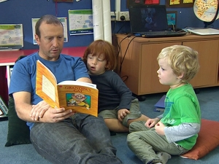
Shared Reading
Supporting the student to actively participate in the interaction
Supporting the student’s learning of specific literacy skills
How we read is critical

Slide 15
Criteria for Effective Shared Reading
Student is engaged (observable, measurable)
Looking at the book
Touching pictures or symbols
Turning pages
Shifting attention from book to adult
Responding through speech, gesture, symbols
Affect is positive
Engagement is sustained
Repeated readings of the same text with different purposes

Slide 16
What do students learn during shared reading?
How and why we use books
Background knowledge
Vocabulary
Concepts about print
How meaning is made from print
Reading is worthwhile and enjoyable
Connection between spoken word and print

Slide 17
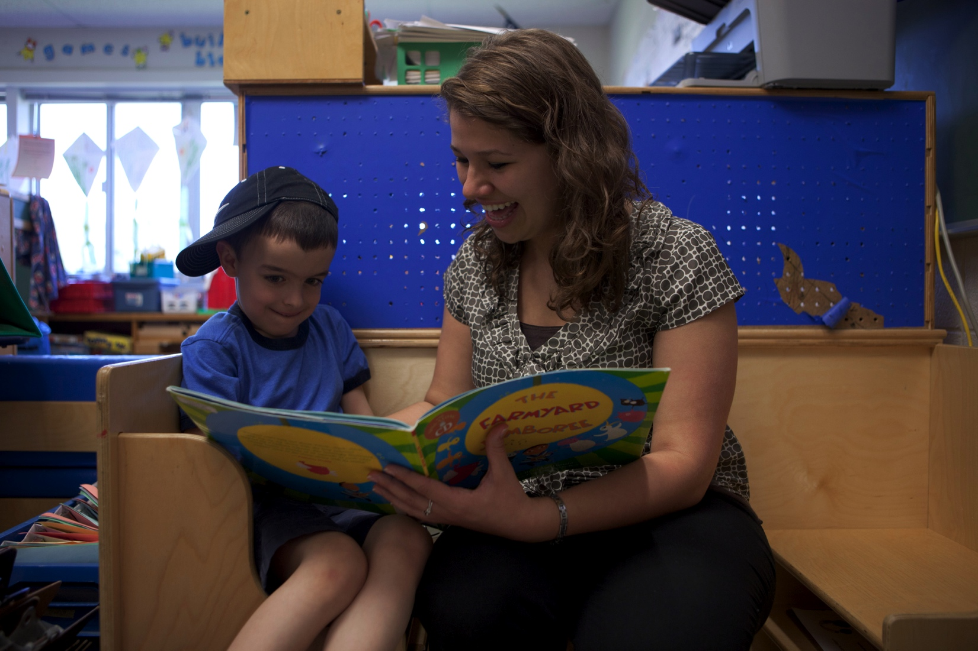
Being a Literacy Partner
Educators use a certain type of questioning style to change the interaction from passive to active
Educator provides feedback and follow up questions to create linked turns: “dialogue”

Slide 18
Dialogic Reading
Developed by Dr. Grover Whitehurst
Scaffolding method to actively engage student language, vocabulary and literacy development
Child led (with the support of an adult)
Conducted 1:1 or in a small group
Adult becomes the listener, the questioner and the audience as the child becomes the storyteller

Slide 19
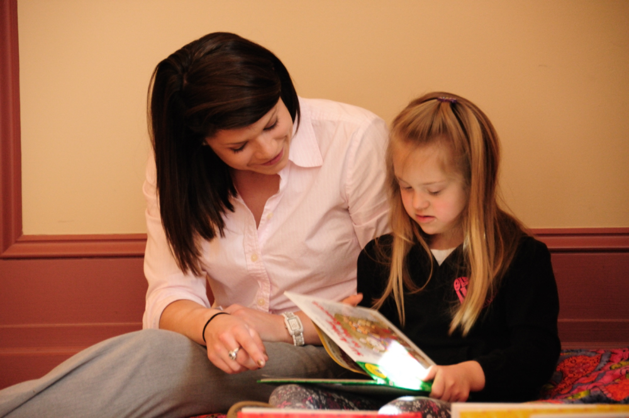
Dialogic Reading
Fundamental reading technique is the PEER sequence
The adult:
Prompts the child to say something about the book
Evaluates the child’s response
Expands the child’s response by rephrasing and adding information to it and,
Repeats the prompt to make sure the child has learned the expansion
Remember to wait for a response and give appropriate support if necessary

Slide 20
PEER sequence
Prompts the child to say something about the book | What does the dog say?
Evaluates the child’s response | That’s right, a dog says woof, woof!
Expands the child’s response | And a cat says meow.
Repeats the prompt | What does a cow say?

Slide 21
Dialogic Prompts = CROWD
Completion Prompts: you leave a blank at the end of the sentence and get the student to fill it in. Completion prompts provide children with information about the structure of language that is critical to later reading.
Recall Prompts: questions about what happened in a book a child has already read. They help children understand story plot.
Open-ended Prompts: focus on the pictures in books. They help children increase their expressive fluency and attend to detail.
Wh-prompts: what, where, when, why and how questions. They often focus on the pictures or actions in a story. They can teach new vocabulary to children.
Distancing prompts: These ask children to relate the pictures or words in the book they are reading to experiences outside the book. They build a bridge between books and the real world, as well as helping with verbal fluency, conversational abilities and narrative skills.

Slide 22
CROWD Prompts
Completion prompts – the child is asked to complete sentences in familiar book | I do not like Green Eggs and Ham, I do not like them Sam I ____.
Recall prompts – the child is asked about what happened in a story that’s already been read | Did Sam like Green Eggs and Ham?
Open-ended prompts – use the picture and the story | What is Sam doing in this picture?
Wh prompts – ask what, when, where and why questions | What is Sam holding?
Distancing prompts – the child is asked to relate the book to events or situations in their own life | Look at Sam’s doggy. Do you have a doggy?

Slide 23
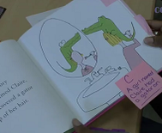
Dialogic Prompts
Distancing prompts and recall prompts are more difficult than completion, open-ended and recall prompts
Usually introduced after the first reading
Used with each page, but usually only 2-3 prompts with each page
Dialogic reading becomes like a conversation about the book, with the child leading the talk

Slide 24


Dialogic Reading
1
2

Slide 25
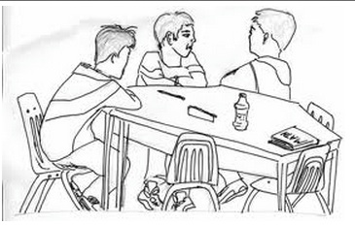
Activity: Dialogic Reading
Work in groups of 3
Rotate roles: EA, student & observer
EA engage student in dialogic reading
Observer: complete observation form
What are your challenges in reading with a student this way?

Slide 26
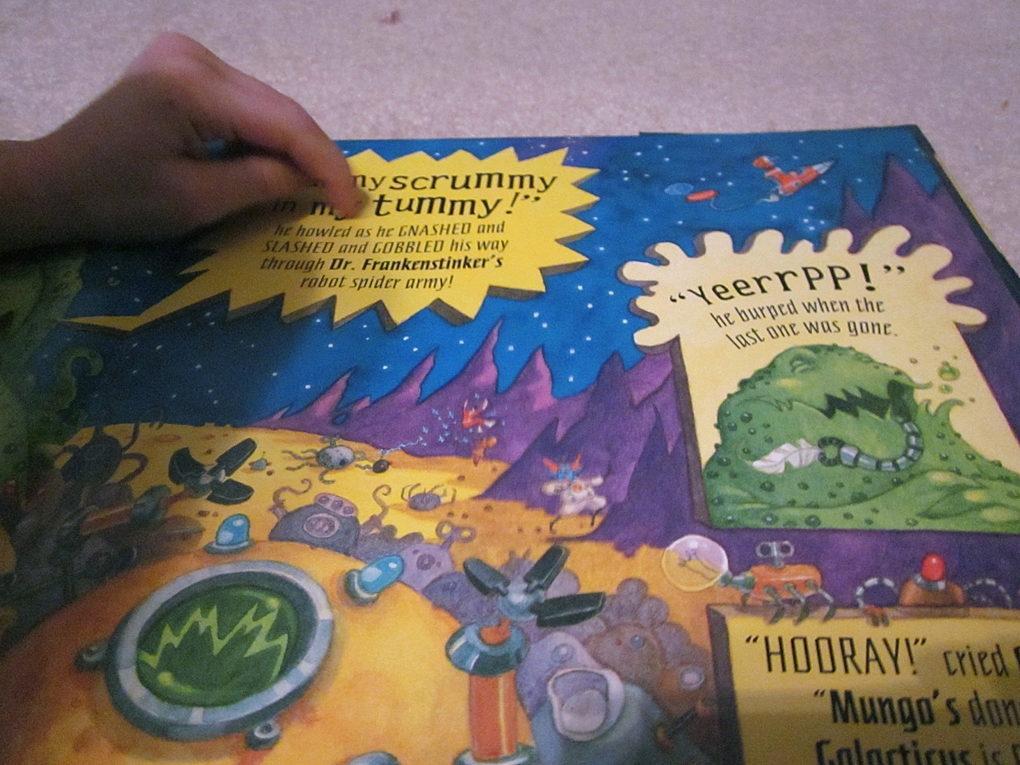
Print Referencing – another part of interactive reading
Part of the larger literacy area of Print Awareness
Print in the everyday environment
How printed language works
Covers skills such as
Concepts about print
Awareness of words as units of print
Alphabetic knowledge

Slide 27
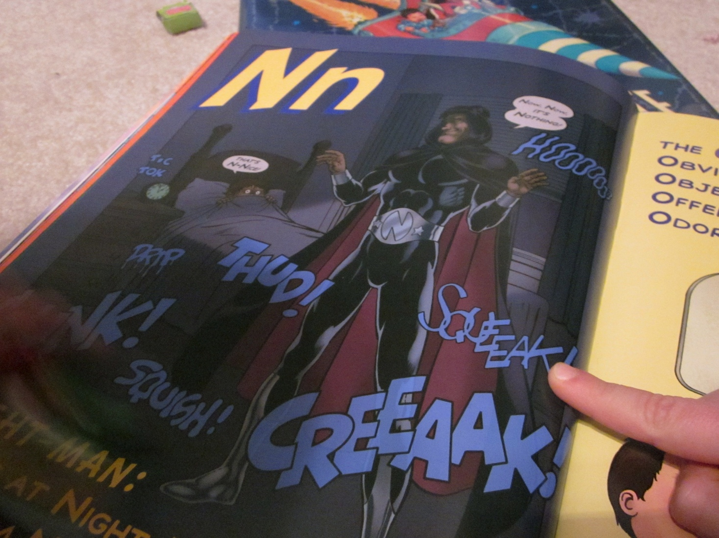
Print Referencing
Done during interactive reading
Part of the interaction but relies more on the adult’s input
Make specific verbal and nonverbal references to print
Ask questions and make comments about the print and illustrations
Point out and track the book’s print

Slide 28
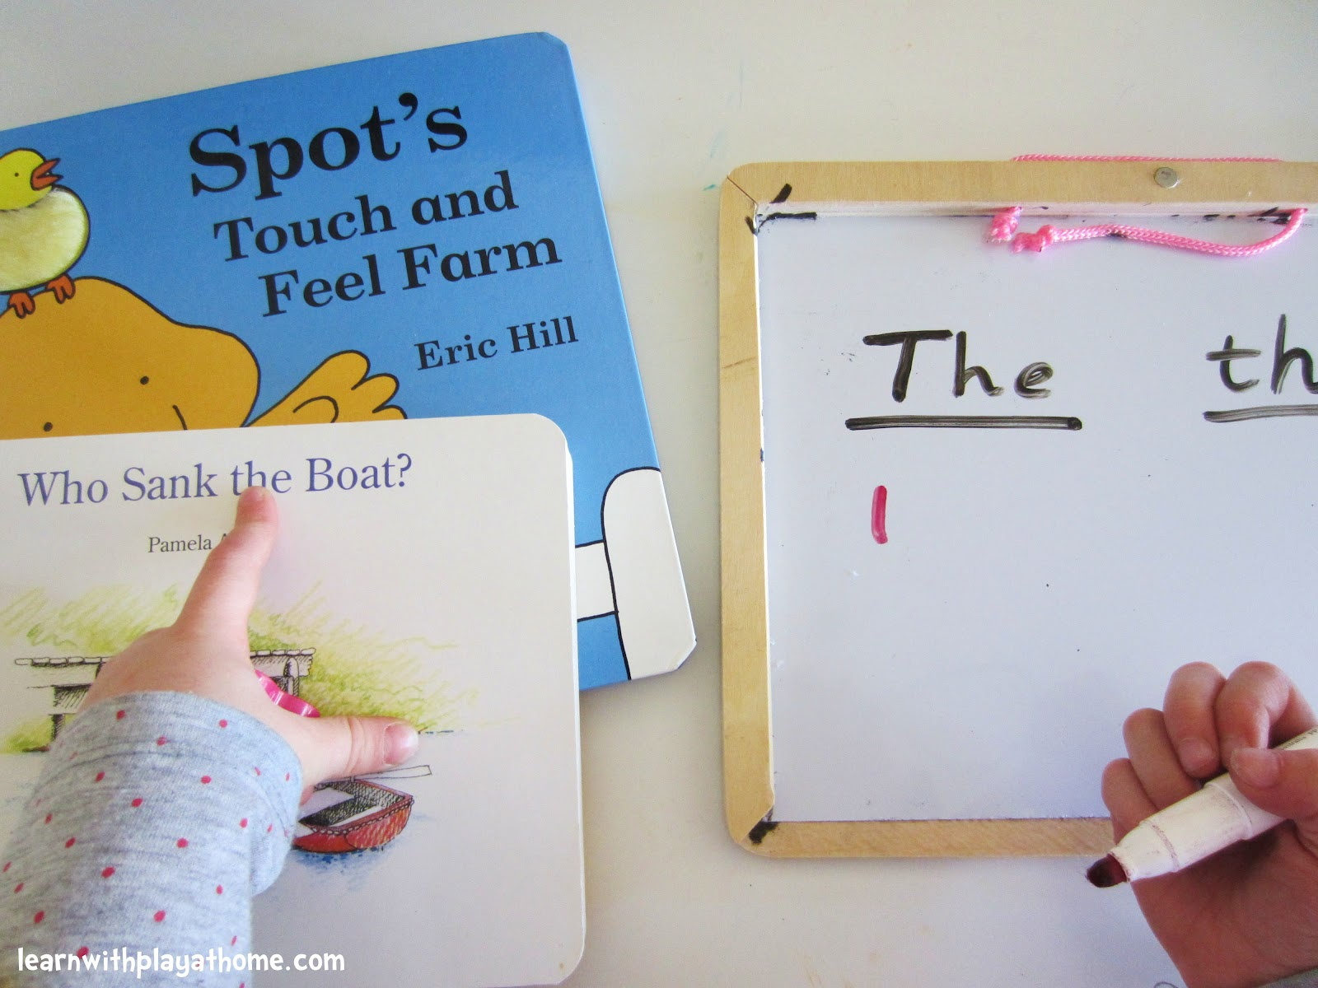
Verbal Strategies
Adult asks questions about print: What is this letter?
Adult comments about print: This is an “A”.
Adult request about print: Show me the “O”.

Slide 29
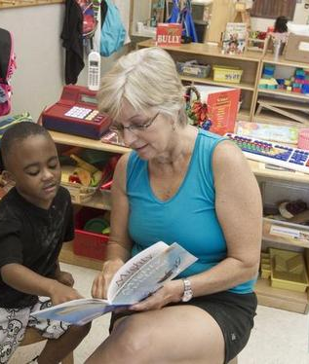
Non verbal strategies
Pointing to print while reading a story
Matching word to word or phase to phrase
Student puts phrase cards in order to form a story
High lighting (pen or ruler) letters, words or phrases

